Slide 1
Employee Data Analysis using Excel
STUDENT NAME : HEMAVARDHINI P.
REGISTER NO : 2213371036014
NM ID :6BB4DED14CD14C2AA104CEF29EB1733C
DEPARTMENT : B COM COMMERCE
COLLEGE : QUAID-E-MILLATH GOVERNMENT COLLEGE FOR WOMEN

Slide 2
PROJECT TITLE
Employee Performance Analysis using Excel

Slide 3


AGENDA
Problem Statement
Project Overview
End Users
Our Solution and Proposition
Dataset Description
Modelling Approach
Results and Discussion
Conclusion

Slide 4

PROBLEM STATEMENT
To overview the peformance of the employees for the organisational development.
To select the employees who achieved more for the organisation.
To recognise the employee by their performance.

Slide 5

PROJECT OVERVIEW
Employee performance analytics is the act of analyzing HR data to measure how your employees are performing against KPIs. These KPIs are role-specific performance goals, metrics, or standards that are tied to your larger business goals.
A needs analysis defines deficiencies or problems and identifies causes and solutions. It can be thought of as the process of identifying gaps between what should be happening and what is happening, and accounting for the causes of these gaps.

Slide 6
WHO ARE THE END USERS?
Employer
Employee
Organiszation
IT sector
Managers
Management heirarchies

Slide 7

OUR SOLUTION AND ITS VALUE PROPOSITION
Conditional Formatting - To remove blank
Formulae - To overview the performance level
Auto Filter - To take the necessary data
Graph - To visualize the data
Pivot Table - To get the summary

Slide 8
Dataset Description
Employee data set - Kaggle
Total features - 26
Considered - 9 features
Employee ID
Employee name
Employee type
Performance level
Gender ID
Employee Rating

Slide 9

THE "WOW" IN OUR SOLUTION
Analysing Employee Performance by graph
visualization & Summary table
9

Slide 10
MODELLING
Data collection 1. Raw data from Kaggle
2. Analysing it through Excel
Feature collection
1. Looking it through Pivot table & overview the results by applying Formulae
2. Formulae enhances to get the result for their individual act
Data cleaning
1. Sort out the unnecessary data by filtering option
2. Taking out considered data by Pivot able.
10

Slide 11
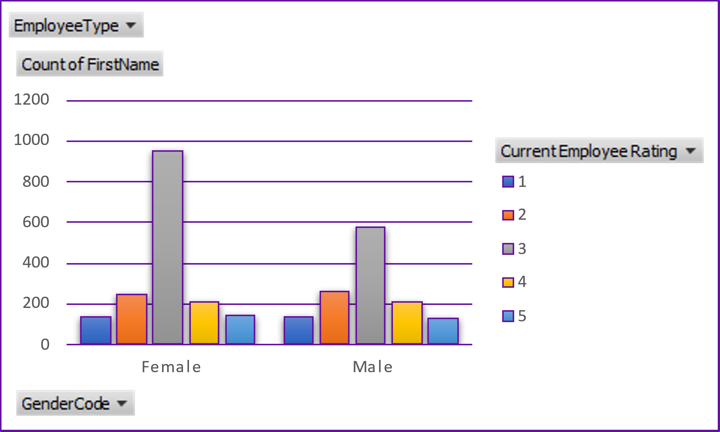
RESULTS of Employee Performance Analysis
11

Slide 12
conclusion
*Role Distribution*: If this data is about employee distribution, it looks like certain roles have higher counts or more significant performance metrics. For instance, roles like "Labour" or "Foreman" might have more employees or higher performance metrics than roles like "Billing" or "Driver".
*Diversity Analysis*: If the data includes demographic breakdowns, there may be insights on diversity in different roles. For example, you might conclude if certain roles have more diversity compared to others.

